Slide 1



Depression Tendency Prediction
Presented by Duy Khanh

Slide 2
Abstract
The goal of this project is to predict characteristics that influence an individual's mental health utilizing classifier models such logit regression and random forests. Data is gathered on a group of people with a wide range of living situations, health, and socioeconomic status.
Presented by Duy Khanh

Slide 3
Agenda Overview
01
Problem Statement
04
Predicting with Classification Model and Evaluation
02
Data Understanding and Preparation
05
Actionable Recommendation
03
EDA and Visualization
06
Conslusion
Presented by Juliana Silva

Slide 4
Problem
01
02
03
What are the significant life, economic, and social factors that greatly influence the development of psychological disorders?
Exploring the key factors that influence and can predict the development of depression in an individual
Predicting, preventing, and assisting individuals who may have mental health issues and those who already have mental health problems.
Presented by Duy Khanh

Slide 5
Data Understanding and Preparation
This dataset contains information on individuals with various attributes related to their personal and lifestyle factors. It is designed to facilitate analysis in areas such as health, lifestyle, and socio-economic status. It includes 16 columns divided into 4 feature groups as follows:
Presented by Duy Khanh

Slide 6
Data Understanding and Preparation
Demographuc Information
Health and Lifestyle
Socioeconomic Status
Mental Health History
Name
Age
Marital Status
Number of Children
Education Level
Smoking Status
Physical Activity Level
Alcohol Consumption
Dietary Habits
Sleep Patterns
Chronic Medical Conditions
Employment Status
Income
History of Mental Illness
History of Substance Abuse
Family History of Depression

Slide 7
Data Understanding and Preparation
Data Checking
Checking missing values, inconsistencies, potential outlier, duplicates,..
Data Preparing
Remove the column containing personally identifiable information.
Convert categorical features (e.g., Marital Status, Smoking Status) into numerical values.
Scale numerical features (e.g., Age, Income) to a standard range to ensure the models perform optimally.
Presented by Duy Khanh

Slide 8
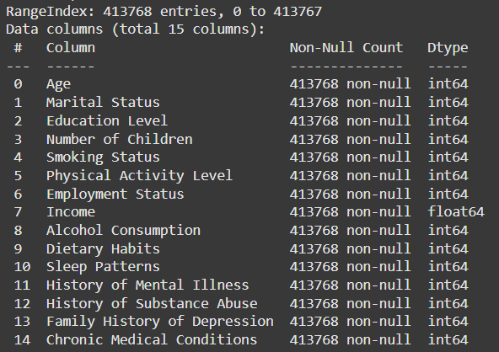
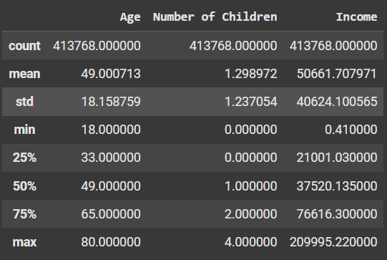
Data Understanding and Preparation
Presented by Duy Khanh

Slide 9
EDA and Visualization
Overview
Grouping the factors, calculating, and visualizing them using charts show that the dataset is collected from individuals aged 18 and above, categorized quite thoroughly and evenly. The dataset is gathered from individuals with diverse aspects in all areas. Therefore, this dataset is highly comprehensive when applying mental health prediction models.
Presented by Duy Khanh

Slide 10
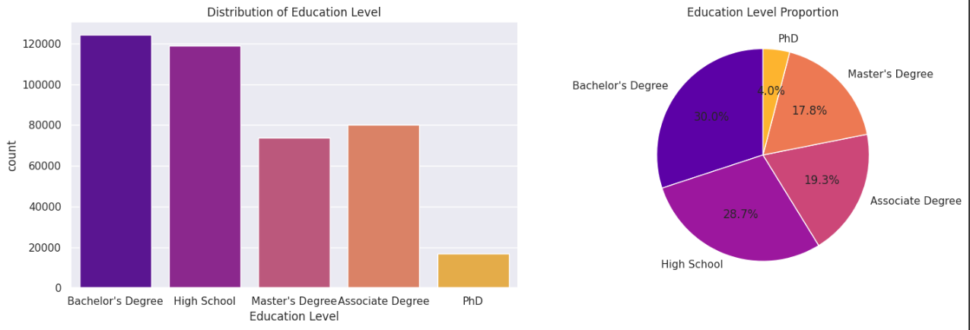
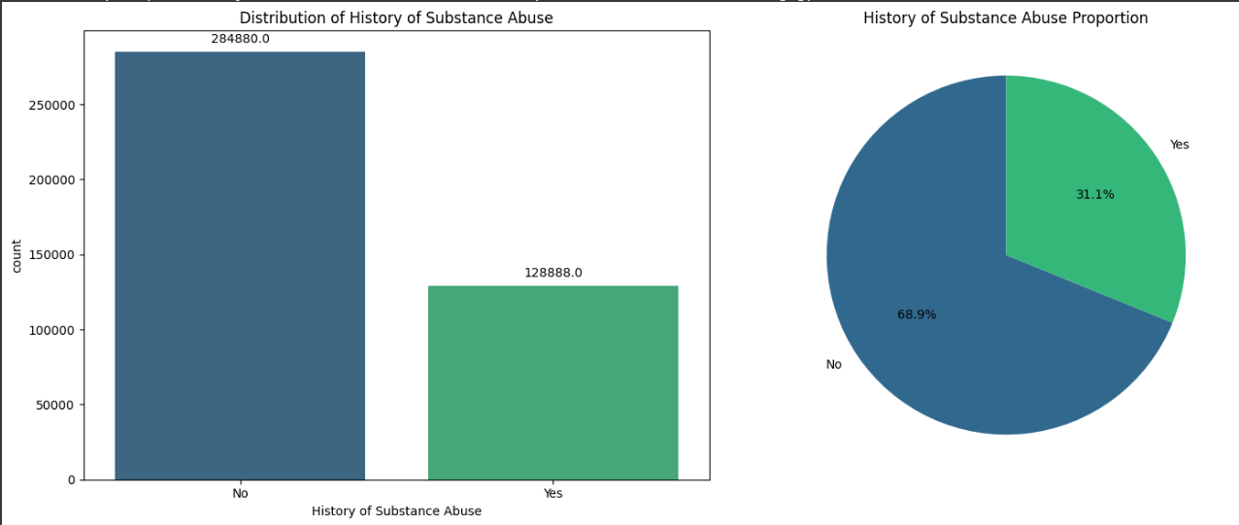
Education Level
History of Substance Abuse

Slide 11
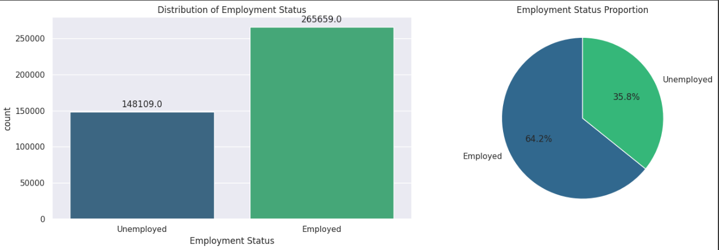
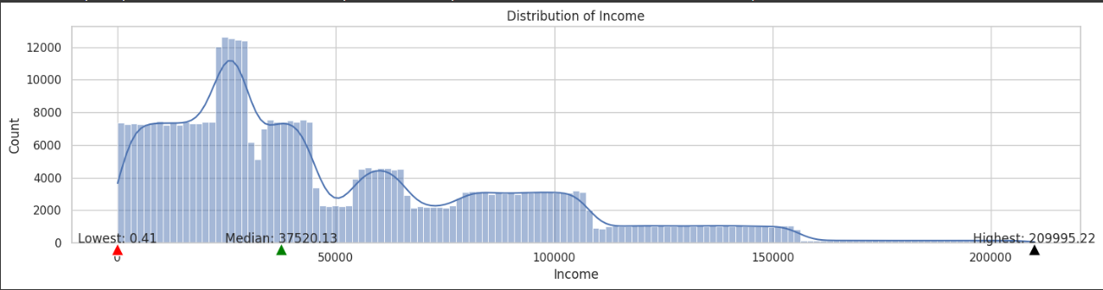
Employment Status
Income

Slide 12
EDA and Visualization
Additional
Grouping the factors into different categories helps to gain clearer insights into the relationships and influences between the features, especially the relationship between History of Mental Illness and other features.
Presented by Duy Khanh

Slide 13
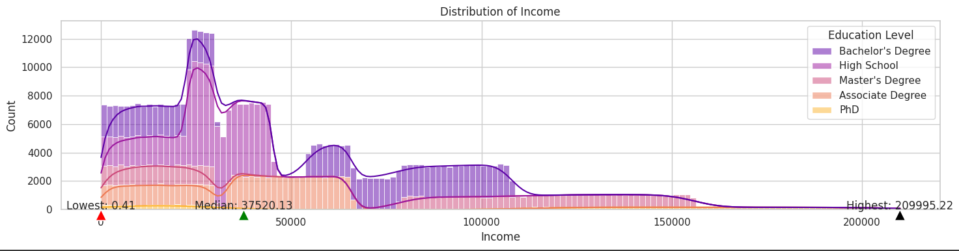
Relationship between Income and Education Level

Slide 14
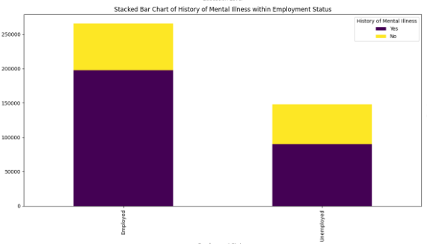
Relationship between History of Mental Illness and Employment Status

Slide 15
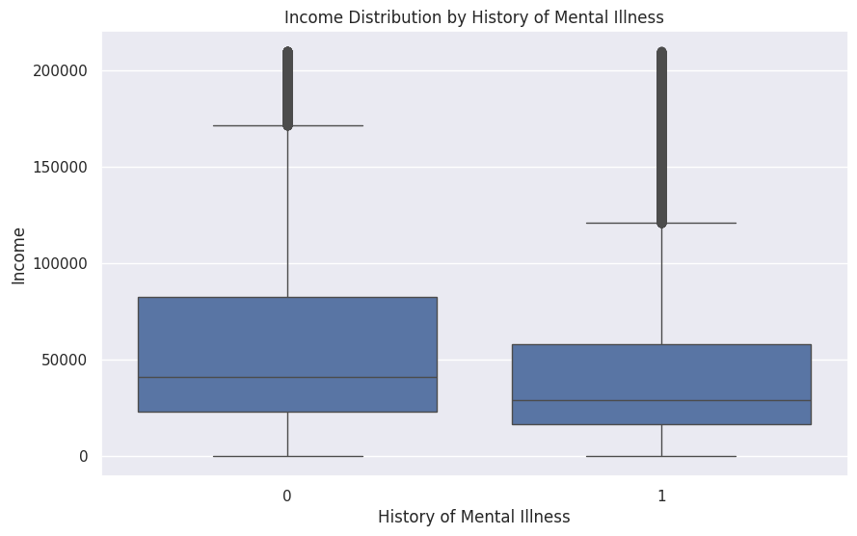
Relationship between History of Mental Illness and Income

Slide 16
EDA and Visualization
Key Features
1. Marital Status: Single, divorced, and widowed individuals show a higher count of history of mental illness compared to married individuals.
2. Education Level: Individuals with lower education levels (e.g., no formal education or primary education) show a higher count of history of mental illness compared to those with higher education levels (e.g., college or university degree).
3. Employment Status: Unemployed individuals have a higher count of history of mental illness compared to employed individuals.
4. History of Substance Abuse: Individuals with a history of substance abuse show a higher count of history of mental illness compared to those without.
5. Family History of Depression: A family history of depression is associated with a higher count of history of mental illness.
6. Income: Individuals with no history of mental illness tend to have higher median incomes compared to those with a history of mental illness
Presented by Duy Khanh

Slide 17
Depression Predicting with Classification Model and Evaluation
Presented by Duy Khanh

Slide 18
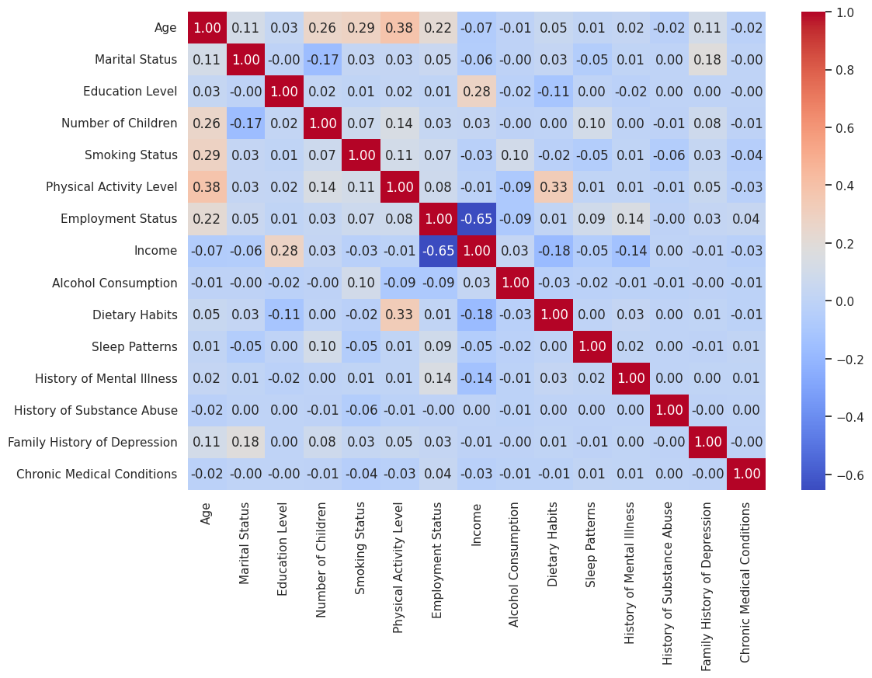
Correlation Matrix
Employment Status: 0.14
Indicating that individuals with a history of mental illness are more likely to be unemployed.
Income: -0.14
Suggesting that individuals with a history of mental illness tend to have lower incomes.
History of Substance Abuse: 0.14
Indicating that individuals with a history of mental illness are more likely to have a history of substance abuse.

Slide 19
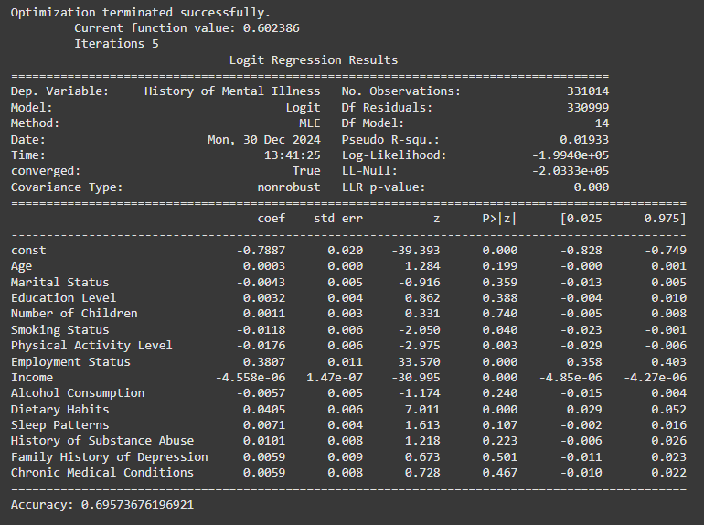
Logictis Regression Model
Model Accuracy: 69,5%
Significant Predictors:
Income
Employment Status
History of Substance Abuse
Family History of Depression

Slide 20
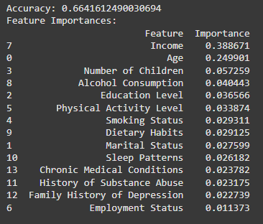
Random Forrest Model
Model Accuracy: 66,4%

Slide 21
Actional Recommendation
Family
Social workers
Psychologists
Income support.
Physical Activity, Dietary Habits and Sleep Pattern.
Assessing economic and financial situations and providing support services for unemployment and job placement are essential. Additionally, workshops and outdoor activities that enhance understanding and awareness of mental health are also very beneficial.
A comprehensive assessment of patients, including factors such as family history, income, employment status, and substance use, is essential in the treatment process. Providing advice on improving mental health by eliminating addictive substances, or incorporating job placement and vocational training during treatment, is crucial.
Presented by Duy Khanh

Slide 22
Conclusion
These systems are based on the significant factors identified in the logistic regression analysis and are aimed at improving the mental health and well-being of individuals through targeted interventions and support. By addressing these factors, families, psychologists, and medical social workers can work together to reduce the tendency of depression and enhance overall mental health outcomes.
Presented by Duy Khanh

Slide 23
Thank
You
Presented by Duy Khanh

